Slide 1
JAVA
UNIT 11

Slide 2
String Length() in JAVA
This function is used to get the length of a Java String. The string length method returns the number of characters written in the String including spaces.
https://www.geeksforgeeks.org/length-vs-length-java/

Slide 3
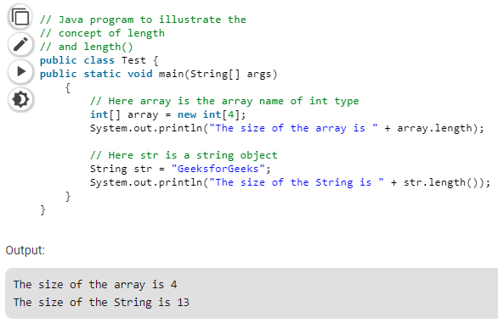
String Length() in JAVA

Slide 4
Special String operations
https://www.javatpoint.com/java-string

Slide 5
StringBuffer class
https://www.geeksforgeeks.org/stringbuffer-class-in-java/

